Slide 1
ALDAR University College
School of Engineering and Technology
I/O Interfacing
Dr. Osama Hosameldeen

Slide 2
What is Serial I/O
Computer input / output techniques fall into one of two basic categories, serial I/O or parallel I/O.
Since microcomputer data busses are 8-bits or a multiple of 8-bits wide, then the most natural and quickest technique of transferring data to or from a computer is to transmit or receive data words which are of the same number of bits as the data bus. This is called parallel I/O.
However, since a single electrical conductor can only carry 1-bit of data at any instant of time, parallel I/O necessitates using multiple conductors to interface the sending or receiving device to the computer.
Although parallel I/O systems are fast, they tend to be expensive and complex.

Slide 3
What is Serial I/O
To reduce cost and complexity of the communications system, data is either sent to, or received from, a computer a bit at a time.
Such systems are referred to as serial I/O systems.
Because data is only sent a bit at a time serial I/O is slower than parallel I/O in terms of data rate. However, with modern technology data can still be transmitted and received serially at rates up to 1000,000,000 bits per second.

Slide 4
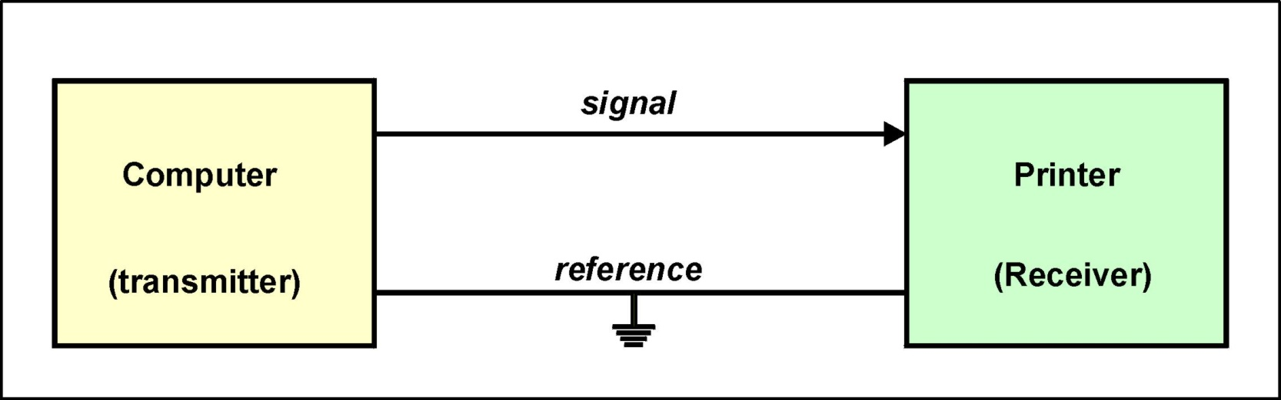
The Simplex System
The simplex system is a serial communications system in which the data flow is uni-directional. It comprises two electrical conductors, a signal wire and a reference.
In the example the computer is the source of the data ( transmitter )
and the printer is the destination for the data ( receiver ).

Slide 5
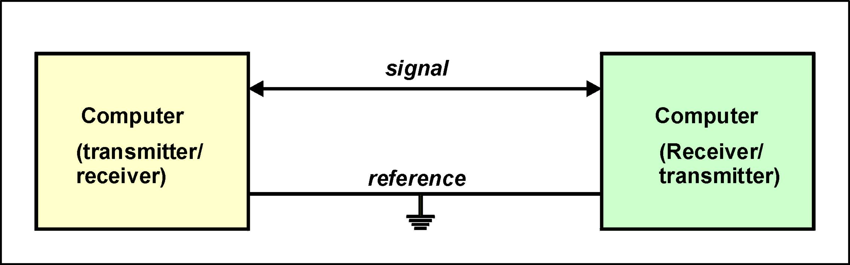
The Half-duplex System
A half-duplex system is also a two wire system, with a signal wire and a reference.
Data flow is bi-directional but only in one direction at any instant in time.

Slide 6
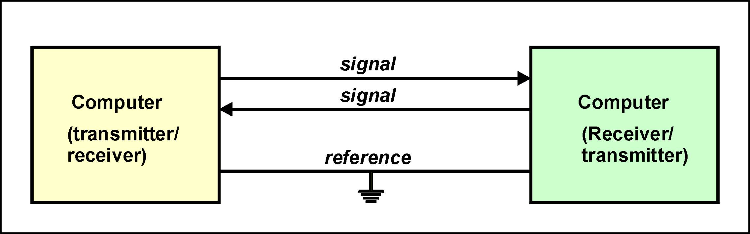
The Full-duplex System
The full-duplex communication system, in its simplest form, can transmit and receive serial data simultaneously.
It requires a minimum of two signal wires together with a reference.

Slide 7
Limitation on Data Rates
Data rates are limited by the bandwidth of the transmitter and receiver.
Data rates are limited by the bandwidth of the interconnecting medium ( copper cable, fibre optic cable, telephone channel, radio channel etc. )
Data can only be received without error provided that the transmitting device does not send data at a faster rate than the receiver can read.

Slide 8
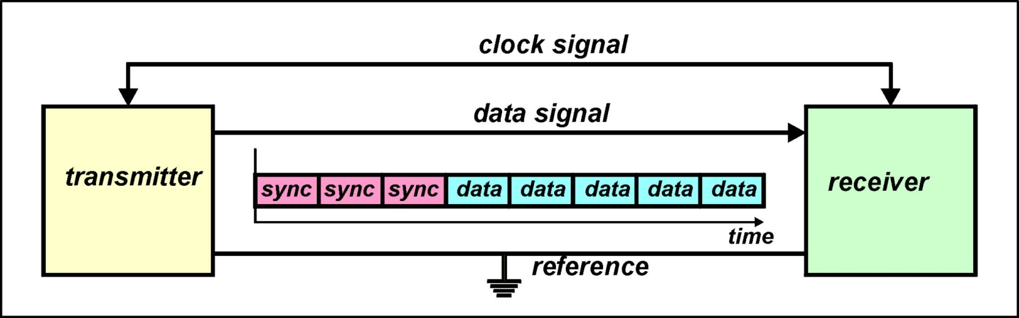
Synchronous Serial Communications
In synchronous communication systems both the transmitter and receiver are referenced to the same clock.
This means that the clock reference has to be transmitted along with the data. There are two approaches to achieving this :
  Transmit the clock along a separate signal wire
  Encode clock information in the data stream

Slide 9
Synchronous Serial Communications
The data is sent as a bit stream.
For the receiver to be able to identify the start and the end of a message, synchronising characters are added to the beginning and the end of the data stream.
The transmitter adds the synchronisation information before the data is transmitted.
Also the transmitter adds data integrity check information, which the receiver can read and determine if it has received the data packet without error.
The main advantage of synchronous communication systems is that data can be transmitted at the clock rate as no synchronisation of transmitter and receiver clocks is necessary.
Synchronous communication systems are rarely used with embedded microcomputer systems and will not be considered further here.

Slide 10
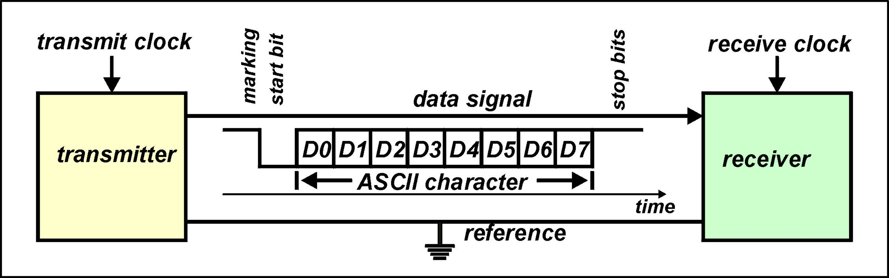
Asynchronous Serial Communications
Most microcomputer systems use the slower, but technically simpler, asynchronous techniques for serial communications purposes.
In asynchronous systems the transmitter and receiver are referenced to their own independent clocks. The clock frequencies are matched as near as is possible - usually by using crystal based oscillators.

Slide 11
Asynchronous Serial Communications
Asynchronous serial communication systems are character based.
One character (6-bits, 7-bits or 8-bits), usually ASCII coded, is sent at a time.
The character is enclosed by synchronising information in the form of :
  a start bit to signify the start of the character
  one (or more ) stop bits to signify the end of the character
A parity bit is often added, by the transmitter, to the end of the character and before the stop bits to enable a degree of error checking by the receiver.

Slide 12
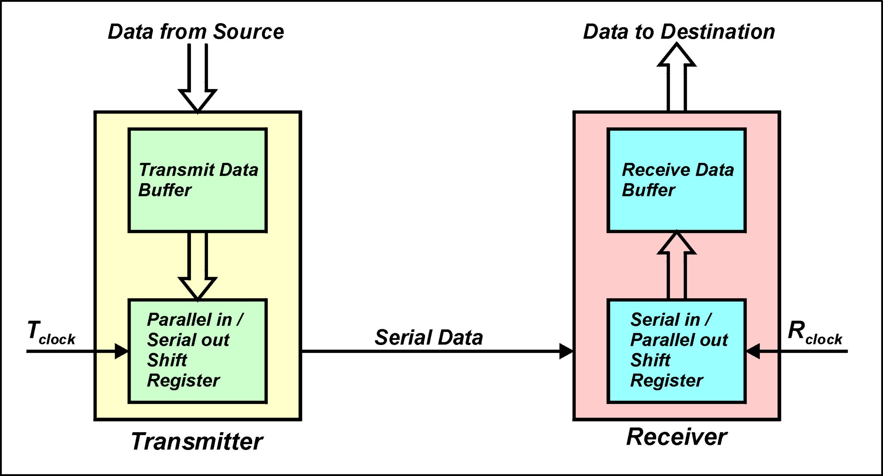
Interfacing a Serial Communications Channel to a Parallel Bus

Slide 13
Interfacing a Serial Communications Channel to a Parallel Bus
When a processor wishes to send data, via the serial channel, it writes parallel data to the transmit data buffer.
Once the previous data has been sent, the data is transferred from the transmit data buffer to a parallel in / serial out shift register.
The shift register, shifts the data out at a bit at a time with respect to the transmit clock. The LSB of the data is sent first.
The receiver collects the incoming data in a serial in / parallel out shift register at a rate determined by the receive clock.
When the full character has been collected the shift register transfers the data, in parallel, to the receive data buffer.
It remains in the buffer until it is read by the receiving processor.

Slide 14
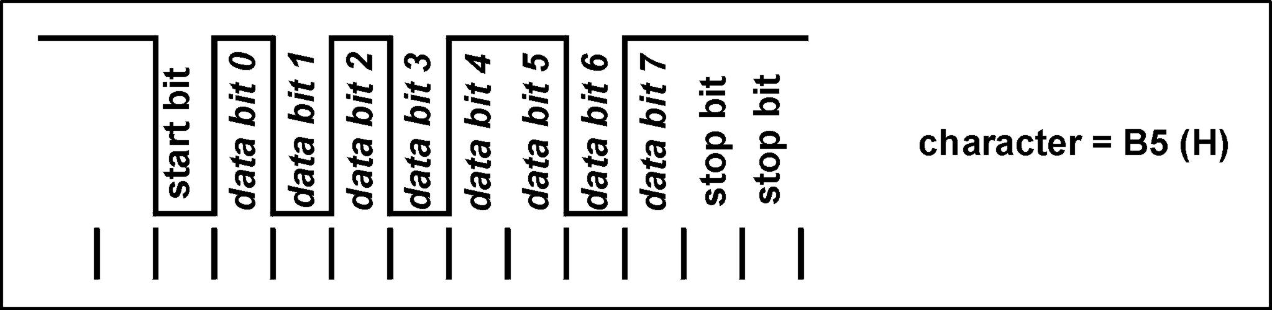
Asynchronous Serial Data Format
When no data is being transmitted the signal wire is held at logic ‘1’ - called a mark.
When transmitting a character it is preceded by a logic ‘0’ (called a space) for one bit time. The space preceding the character is referred to as the start bit.
The bits of the character then follow with the least significant bit (LSB) first and the most significant bit (MSB) last.
One or more logic ‘1’ bits - called stop bits, complete transmission of the character.
The character is said to be framed by the start bits and the stop bits.

Slide 15
Data Rates
The rate at which data is transmitted over a serial communications link is sometimes expressed in bits per second (commonly referred to as Baud rate)
The rate at which data is transmitted over a serial communications link is sometimes expressed in characters per second (commonly abbreviated to cps)
Over the years a number of standard data rates for asynchronous communications systems have been established by manufacturers, including:
  1200 Baud 2400 Baud 4800 Baud 9600 Baud
  19.2 k Baud 38.4 k Baud 57.6 k Baud 115.2 k Baud

Slide 16
Potential Synchronisation Problems with Asynchronous Systems
For an asynchronous serial system to operate without error, the rate at which data is read by the receiver has to be matched to the rate at which the transmitter is sending data.
Data is read by the receiver with respect to the receiver clock.
Data is sent by the transmitter with respect to the transmitters clock.
The question arises “ Does the transmit clock have to be matched to the receive clock, in both frequency and phase, for the received data to be read without error”.
The phase problem is overcome by sampling the received data in the middle of a bit interval. This is achieved by detecting the negative edge of the start bit, wait a half-bit interval and then subsequently sample at full bit intervals. In this manner the incoming data is sampled at approximately the middle of the bit intervals.

Slide 17
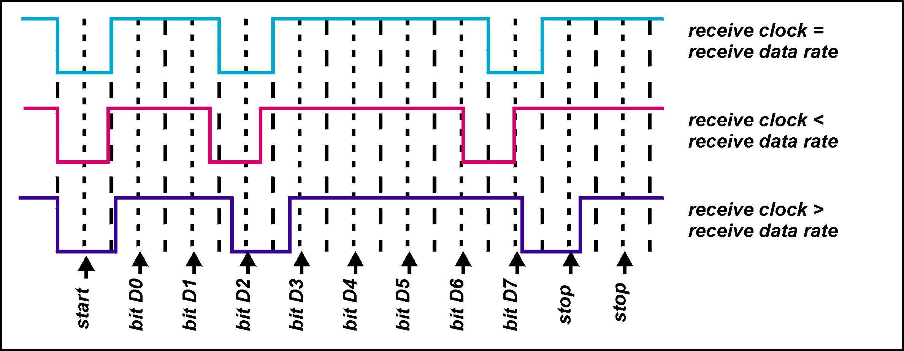
Potential Synchronisation Problems with Asynchronous Systems
The diagram shows three scenarios.
  1. The data rate is precisely the receive sampling rate
  2. The data rate is greater than the receive sampling rate
  3 The data rate is less than the receive sampling rate

Slide 18
Potential Synchronisation Problems with Asynchronous Systems
If the data rate is precisely the same as the receive sampling rate, then the received data will always be sampled in the middle of the bit interval.
If the incoming data rate is either greater or less then the receive sampling rate, then the instant the receive data is sampled will, accumulatively, move away from the middle of the incoming bit interval.
If both incoming data rates and receive sampling rates are stable then the maximum error that can accumulate over one character, and the receiver still read the correct data, is:
The error does not accumulate beyond one character as the system is re-synchronised after every character by the start and stop bits.

Slide 19
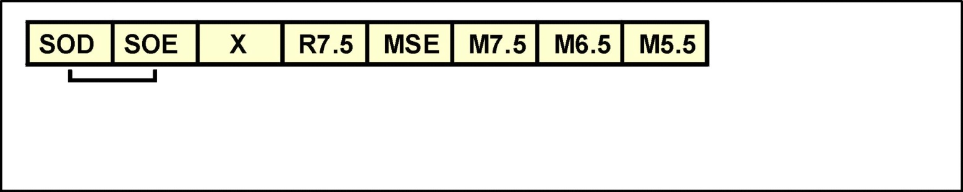
The 8085 Microprocessor have two line specially design for serial transmit and receive data. The two line are SID (Serial Input Data) and SOD (Serial Output Data). Data transfer is controlled using two instructions, SIM (Set Interrupt Mask) and RIM (Read Interrupt Mask). The RIM instruction, read the data from SID pin into Accumulator bit 7. Bit 0 to bit 6 Accumulator represent the interrupt status information in the 8085 system.
SIM instruction will transmit bit 7 in Accumulator through the SOD pin and bit 6 in Accumulator (SOE - Serial Output Enable) must be set to logic ‘0’ in order to enable the transmission.
SOD - Serial Output Data
SOE - Serial Output Enable

Slide 20
Serial data transmission through the SOD line is done by repeating the process of data transmission from the Accumulator to the SOD pin. For example, to transmit serial 8 bits data; the data will be transmit bit by bit through the SOD line using SIM instruction.
The same concept is done for receiving data process which is bit by bit data is received through the SID pin. The method of transmission and reception serial data in digital system usually referred to the standard or specific format such as RS232. Baud rate, parity and stop bit must be considered as an important parameter for the process of transmission and reception serial data.

Slide 21
SIM instructions
      MVI A, 01000000B ; SOD=0
      SIM
      MVI A, 11000000B ;SOD=1
      SIM

Slide 22
How to send 8 bit data?

Slide 23
Sample Program
Baudtime: equ 18
transmit: push h
push b
mov c,a ;4
mvi b,10 ;7
mvi a,01000000b ;7
sim ;4 ;send start bit = 0
tx_loop: mvi h,baudtime ;7
tx_loop1: dcr h ;4
jnz tx_loop1 ;7/10
mov a,c ;4
stc ;4
rar ;4
mov c,a ;4
rar ;4
ani 80h ;7
ori 01000000b ;7
sim ;4
dcr b ;4
jnz tx_loop ;7/10
pop b
pop h
ret ;10

Slide 24
Exercise

